Slide 1


After the Romans 1:
The Early Anglo-Saxons

Slide 2
Key dates
410AD- Romans leave Britain
400s-c.650s Early Anglo-Saxons
C.650s-899 Middle Anglo-Saxons
C.900-1066 Late Anglo-Saxons/Vikings

Slide 3
Key dates
410AD- Romans leave Britain
400s-c.650s Early Anglo-Saxons
C.650s-899 Middle Anglo-Saxons
C.900-1066 Late Anglo-Saxons/Vikings

Slide 4
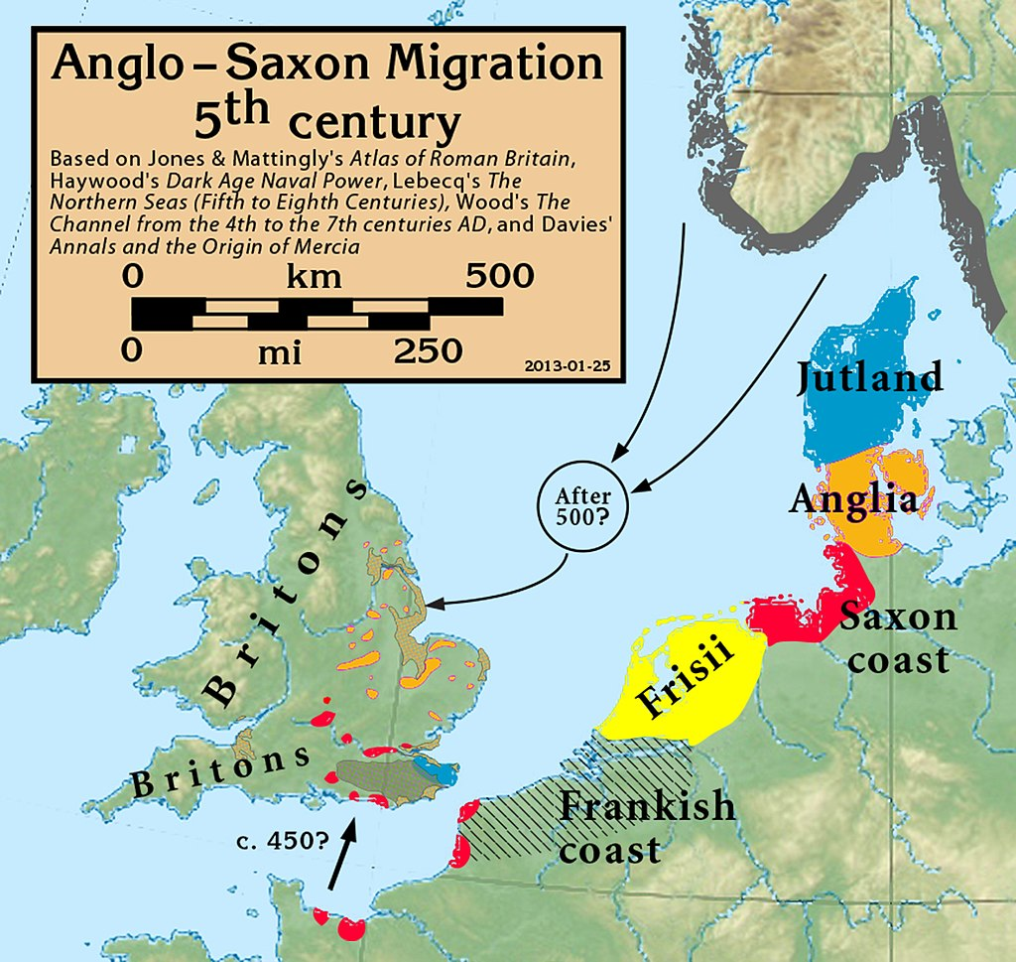
Where did they come from?
CC BY-SA 3.0 <https://creativecommons.org/licenses/by-sa/3.0>, via Wikimedia Commons

Slide 5
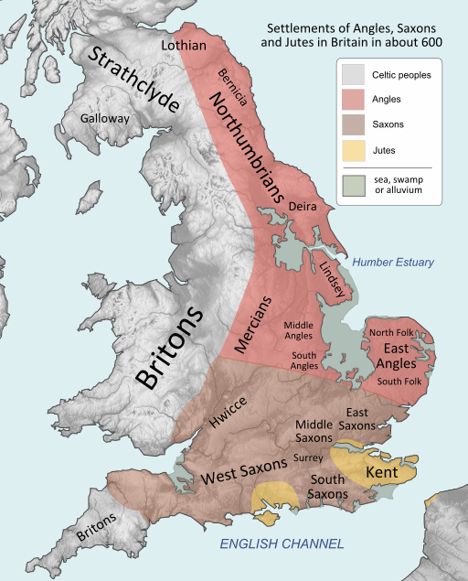
Where did they settle?
User:Hel-hama, CC BY-SA 3.0 <http://creativecommons.org/licenses/by-sa/3.0/>, via Wikimedia Commons

Slide 6
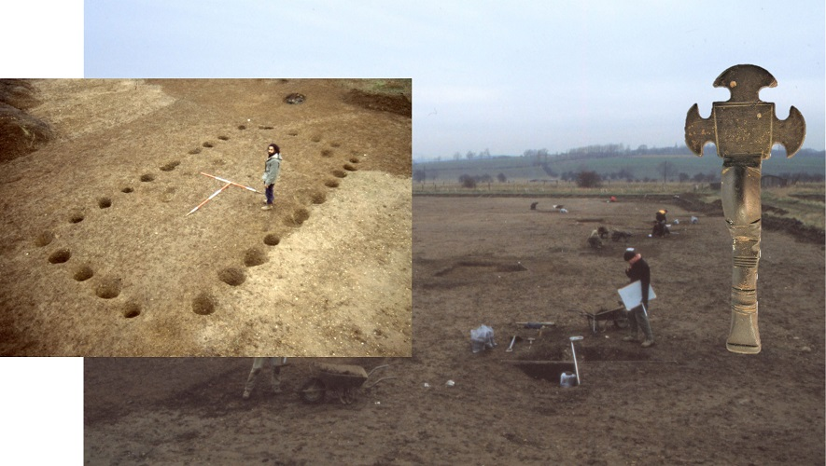
Evidence in Leicestershire?
Excavations at Eye Kettleby (ULAS)
http://kepn.nottingham.ac.uk/map/county/Leicestershire

Slide 7
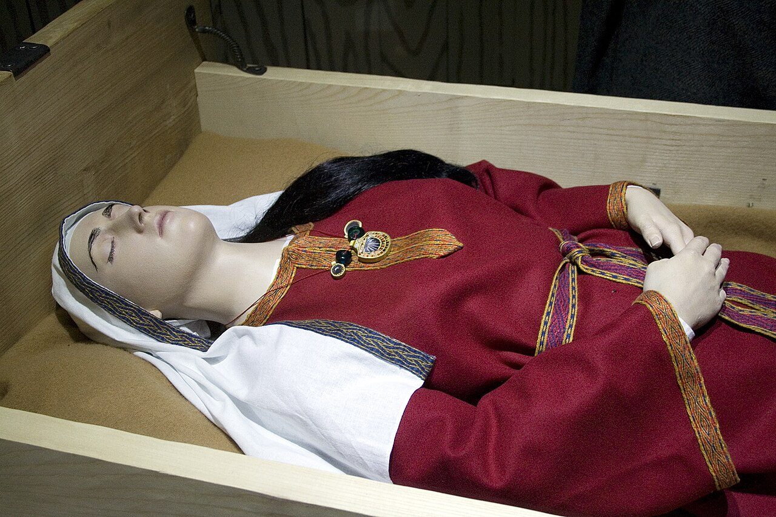
Anglo-Saxon burial
By Prioryman - Own work, CC BY-SA 3.0, https://commons.wikimedia.org/w/index.php?curid=19638838

Slide 8
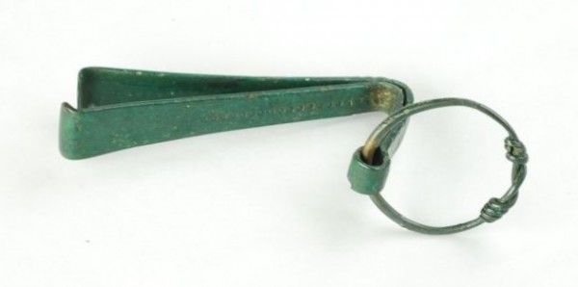
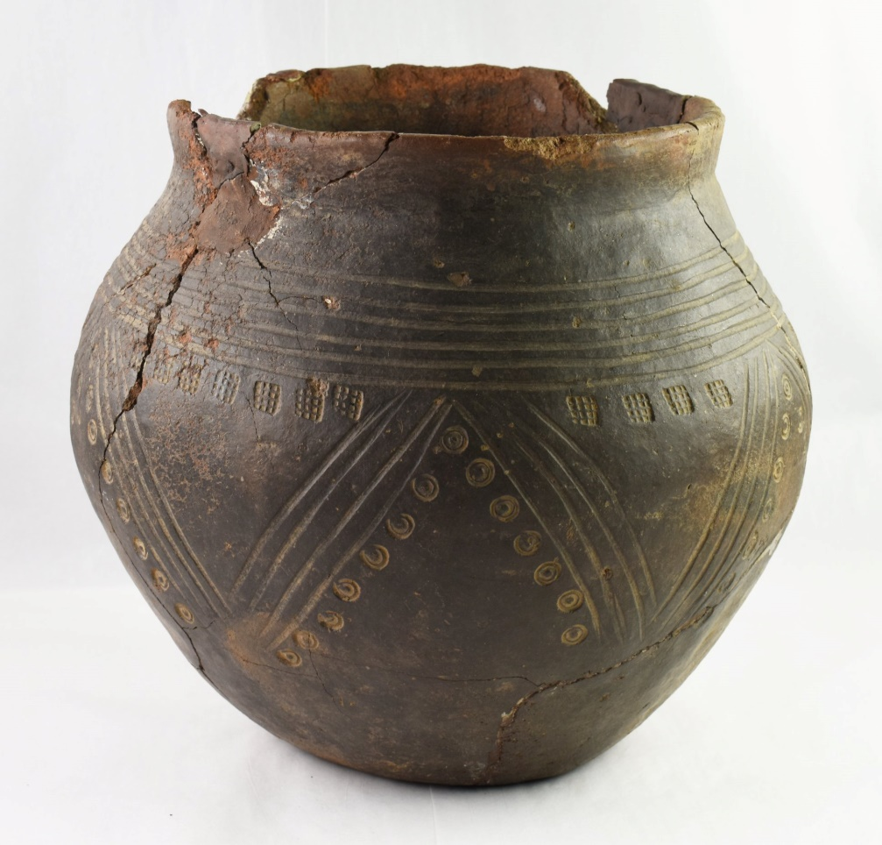
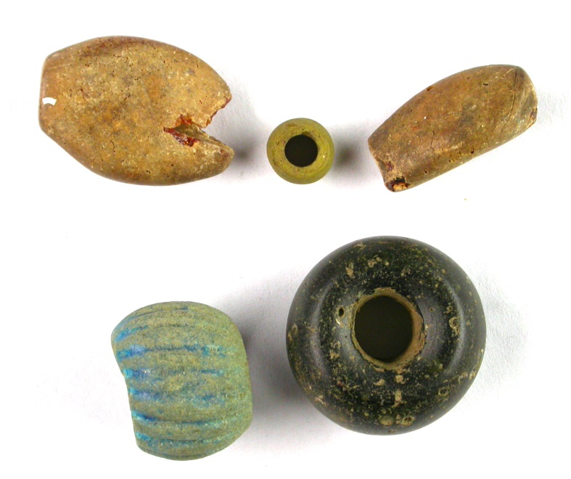
Thurgarton Cremation Cemetery
Melton Mowbray burial

Slide 9
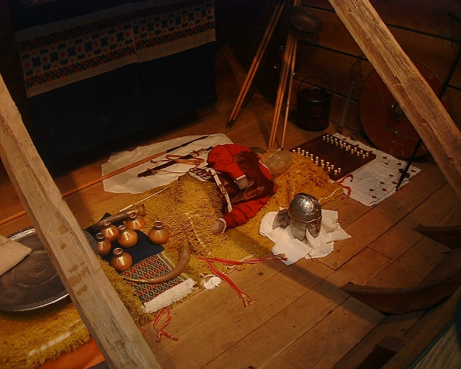
Nigel Freeman / Reconstruction of the burial chamber - Sutton Hoo

Slide 10
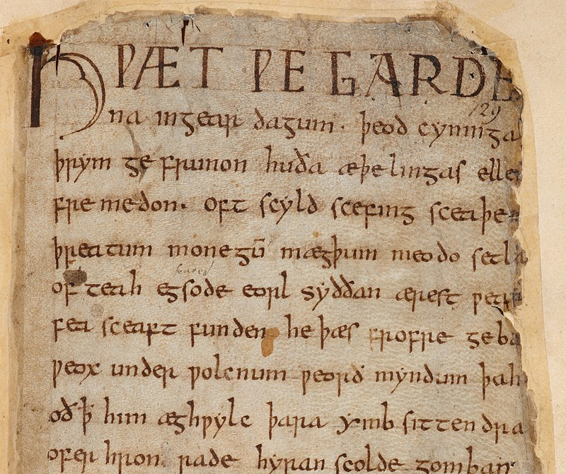
Jewellery, riddles and story telling
By anonymous Anglo-Saxon poet - This file has been provided by the British Library from its digital collections. It is also made available on a British Library website. Catalogue entry: Cotton MS Vitellius A XV, ff 94r–209v, Public Domain, https://commons.wikimedia.org/w/index.php?curid=30380424

Slide 11
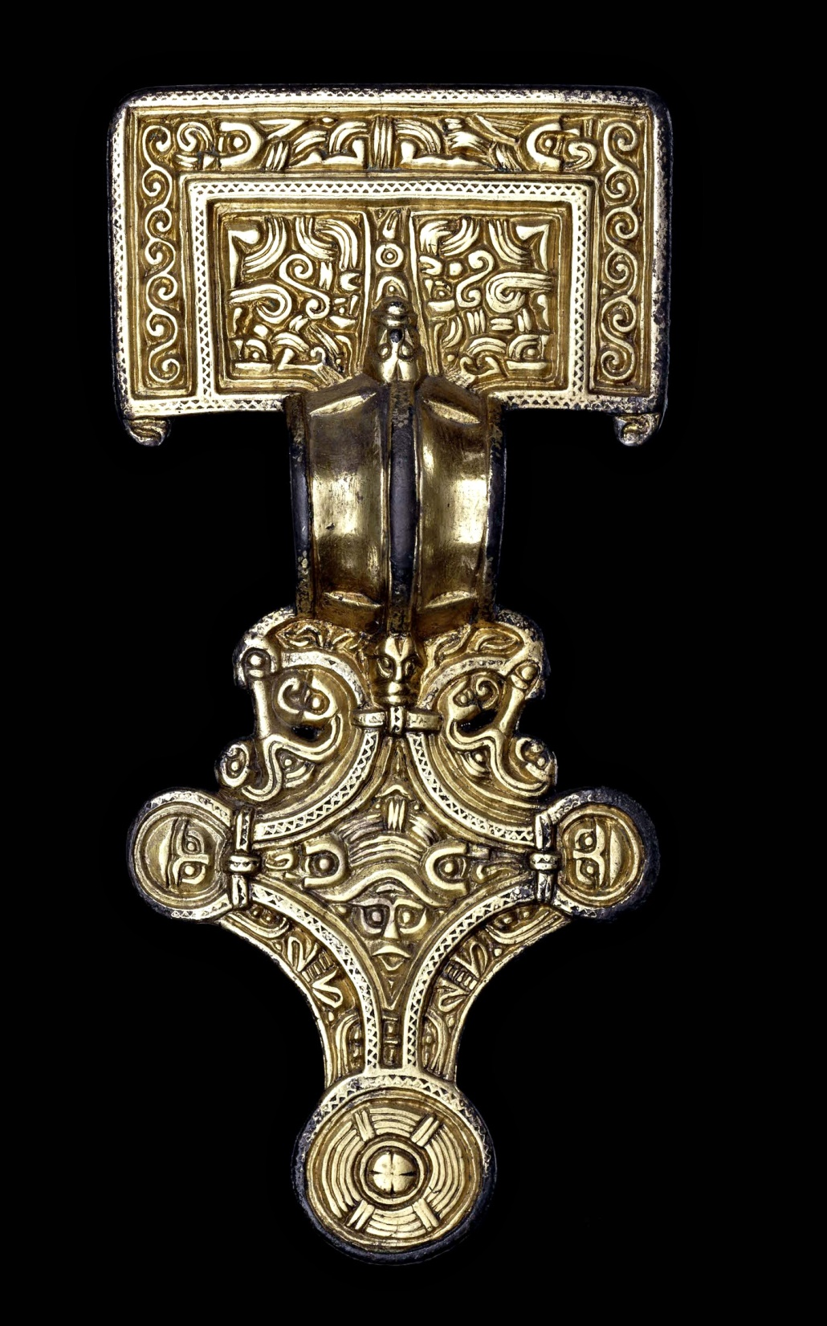
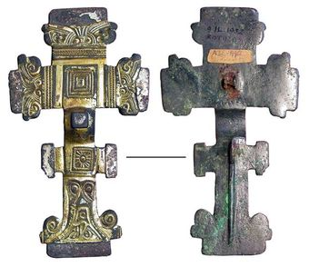
Brooch found at Rothley
©Trustees of the British Museum, CC BY-SA 4.0 <https://creativecommons.org/licenses/by-sa/4.0>, via Wikimedia Commons

Slide 12



Anglo-Saxon kennings / riddles
Heaven’s candle
Whale road
Battle sweat

